Slide 1


Slide 2
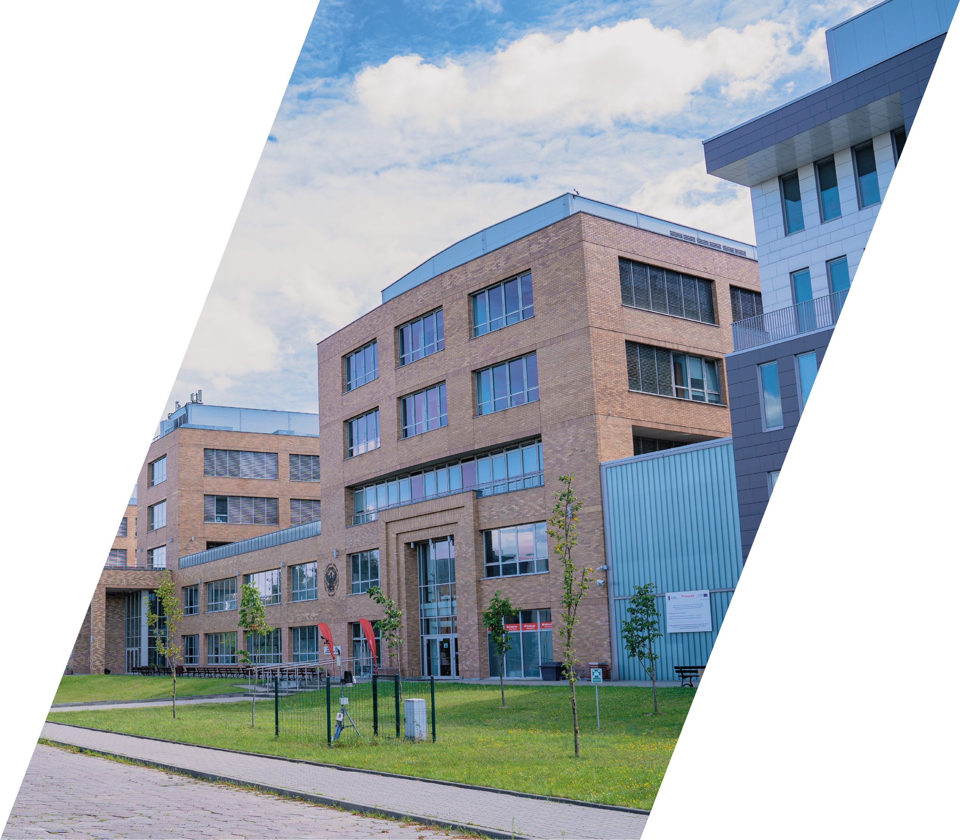

Cardinal Stefan Wyszyński University in Warsaw
is a public university, with its roots in the Academy
of Catholic Theology. As a young university but of rich tradition and modern infrastructure, UKSW offers excellent conditions to widely understood development of the PERSON.
Experienced and highly specialized academic staff of the UKSW consists of nationally and internationally RECOGNIZED SCIENTIST, many of whom receive prestigious awards for scientific research and teaching activities.

Slide 3







3 CAMPUSES
11 000 STUDENTS
100 MAJORS
50 LABORATORIES
450 ADMINISTRATIVE STAFF
800 SCIENTISTS

Slide 4

MORE THAN STUDIES
UKSW consists of 12 faculties, four of which - THEOLOGY, CANON LAW, FAMILY STUDIES, AND CHRISTIAN PHILOSOPHY - are subject to ecclesiastical authorities in addition to the supervision of the Ministry of Education and Science.
Continuous growth and constant development of our University results in opening the new faculties with the FACULTY OF MEDICINE. COLLEGIUM MEDICUM as the youngest unit.
Cardinal Stefan Wyszyński University in Warsaw educates 11 000 students in 95 fields of study, including law, medicine, psychology, journalism, environmental engineering, Italian philology and economics, etc.
UKSW offers first and second-degree as well as a unified master’s degree programme.

Slide 5
FACULTY OF BIOLOGY AND ENVIRONMENTAL SCIENCES
FACULTY OF CHRISTIAN PHILOSOPHY
FACULTY OF MATHEMATICS AND NATURAL SCIENCES. SCHOOL OF EXACT SCIENCES
FACULTY OF MEDICAL SCIENCES. COLLEGIUM MEDICUM
FACULTY OF HISTORY
FACULTY OF EDUCATION
FACULTY OF LAW AND ADMINISTRATION
FACULTY OF CANON LAW
FACULTY OF SOCIAL AND ECONOMIC SCIENCES
FACULTY OF FAMILY STUDIES
FACULTY OF THEOLOGY
FACULTY OF HUMANITIES
FACULTY OF PSYCHOLOGY
FACULTY OF HEALTH SCIENCES
FACULTY OF COMMUNICATION SCIENCES AND JOURNALISM
VARIOUS FACULTIES

Slide 6
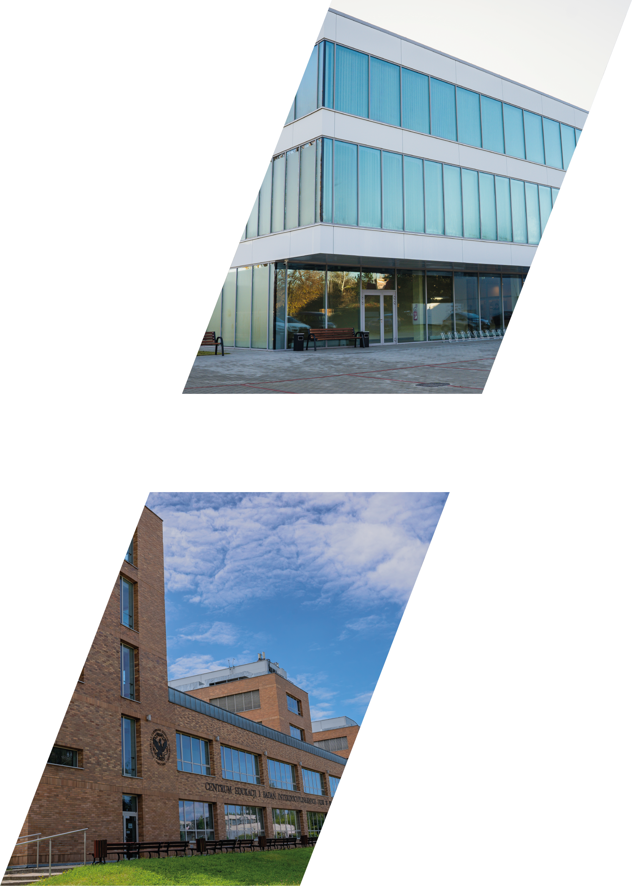
MODERN INFRASTRUCTURE
UKSW’s infrastructure consists of 3 campuses:
BIELANY – DEWAJTIS CAMPUS,
MŁOCINY - WÓYCICKIEGO CAMPUS,
DZIEKANÓW LEŚNY (LOCATED IN THE NORTH OF WARSAW)
At the WÓYCICKIEGO CAMPUS in the Mazowieckie Laboratory Center for Natural Sciences
In DZIEKANÓW LEŚNY, where UKSW campus of a research and scientific nature
is based, a Multidisciplinary Research Center has been launched.
The University holds also state-of-the-art Sports Hall with an auditorium
for 230 seats as well as a modern radio and television studio.

Slide 7
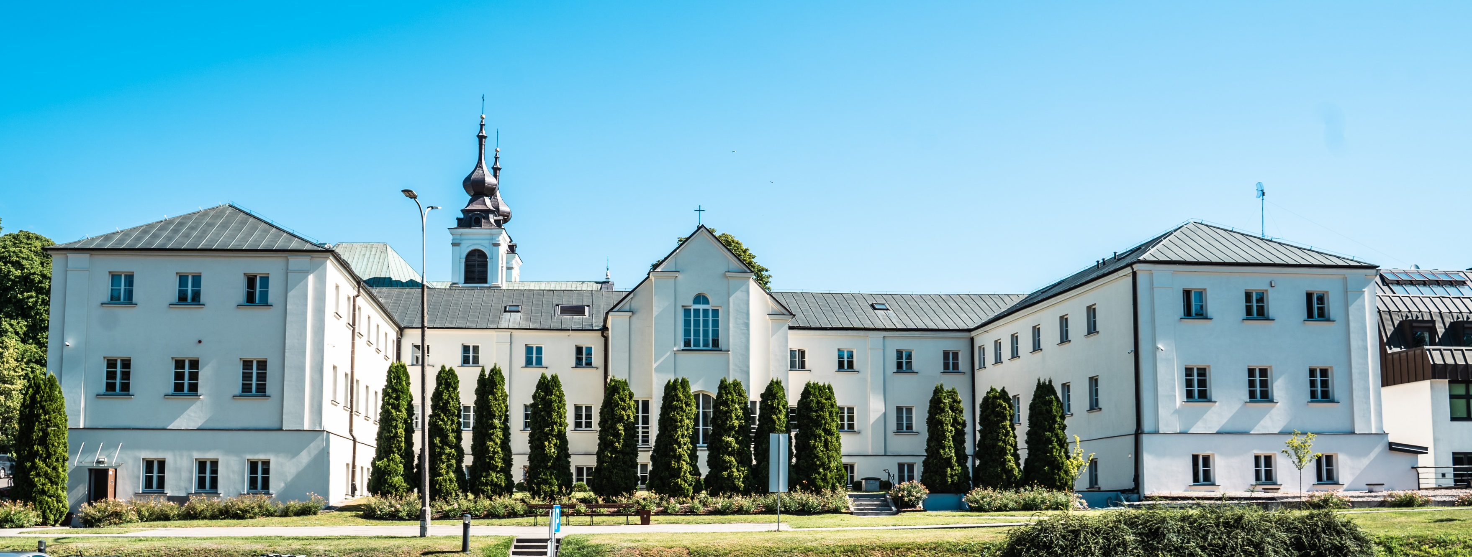
UKSW INVITES TO
explore new fields of knowledge
visit breath-taking places
develop new opportunities

Slide 8
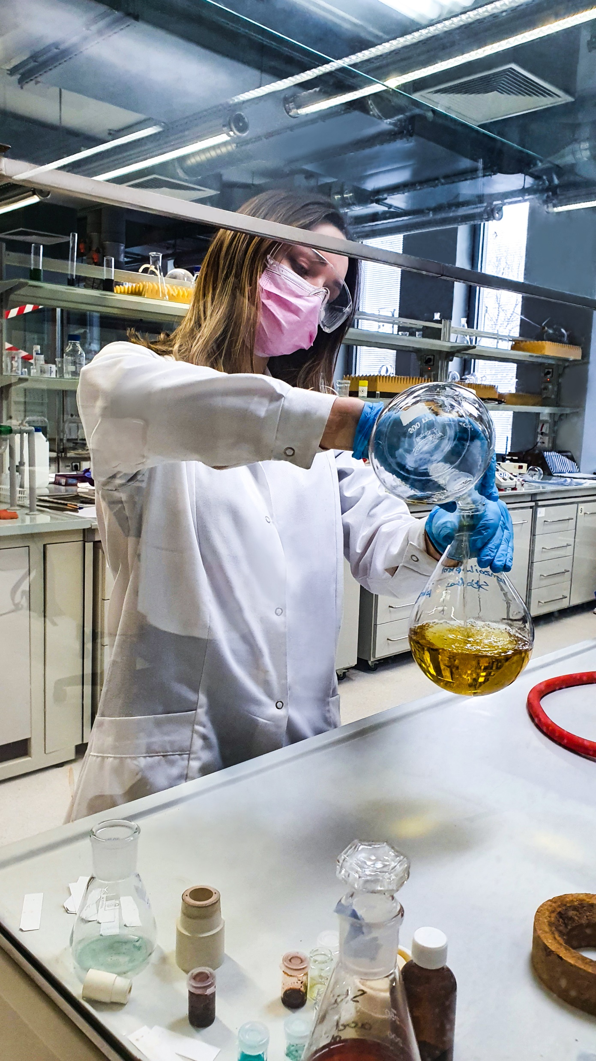
SCIENTIFIC RESEARCH
Cardinal Stefan Wyszyński University in Warsaw employees regularly obtain grants for their research. In the last 2 years financing they gained amounted to over 12 milion PLN. Currently, there are 60 projects run by the UKSW academic staff. Their main source of finance cames from the NATIONAL SCIENCE CENTRE, MINISTRY OF EDUCATION AND SCIENCE, NATIONAL CENTRE FOR RESEARCH AND DEVELOPMENT, AND NATIONAL AGENCY FOR ACADEMIC EXCHANGE.
The main fields of interest for the UKSW academic staff is PSYCHOLOGY, HISTORY, ARCHAEOLOGY, LAW AND ADMINISTRATION, LITERARY STUDIES, THEOLOGY, AND EXACT SCIENCES.
In 2019, The European Commission recognised UKSW with the ‘HR EXCELLENCE IN RESEARCH AWARD’ which confirms the University’s adherence to the principles of the European Charter for Researchers.

Slide 9
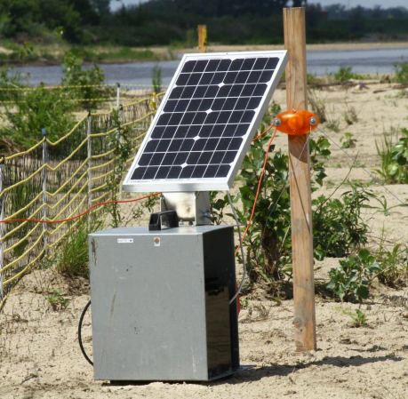
“HIGH-PRESSURE STABILIZATION AND PHASE TRANSITIONS OF ELUSIVE TRANSITION-METAL FLUORIDES”,
“LETTERS OF ZBIGNIEW HERBERT AND KARL DEDECIUS AS A GENERATOR OF INNOVATIVE ACTIVITIES FOR THE POPULARIZATION OF THE LANGUAGE AND POLISH LITERATURE IN THE GERMAN-SPEAKING AREA”,
“EMOTION DYNAMICS AND EMOTION REGULATION IN BORDERLINE PERSONALITY DISORDER AND ANOREXIA NERVOSA. DOWNLOAD METHOD STUDY EXPERIMENTAL SAMPLES (ESM) AND FUNCTIONAL MAGNETIC RESONANCE IMAGING (FMRI)”,
“TURBULENCE AND MAGNETIC RECONNECTION IN THE EARTH’S SPACE ENVIRONMENT”,
“GREENING” OF CATHOLICISM IN POLAND AND ITALY? CATHOLIC ORGANIZATIONS AGAINST CLIMATE CHANGE AND THE ENVIRONMENTAL CRISIS”,
“UNCERTAINTY, INDIFFERENCE, AND AMBIVALENCE IN ROCREATION DECISIONS”.
THE MAIN
RESEARCH PROJECTS:

Slide 10

Erasmus+
CEEPUS
DAAD
Visegrad Fund
Fulbright-Schuman
The Kościuszko Foundation Grants
Józef Tischner Fellowship for Polish and Polish-American Scholars
Fulbright
INTERNATIONAL COOPERATION
Cardinal Stefan Wyszyński University in Warsaw offers various international programmes for Polish and foreign students.
UKSW takes also an active part in Erasmus+ programme cooperating with various universities in order to enable their students to study at UKSW and in order to enable UKSW students to study abroad.

Slide 11
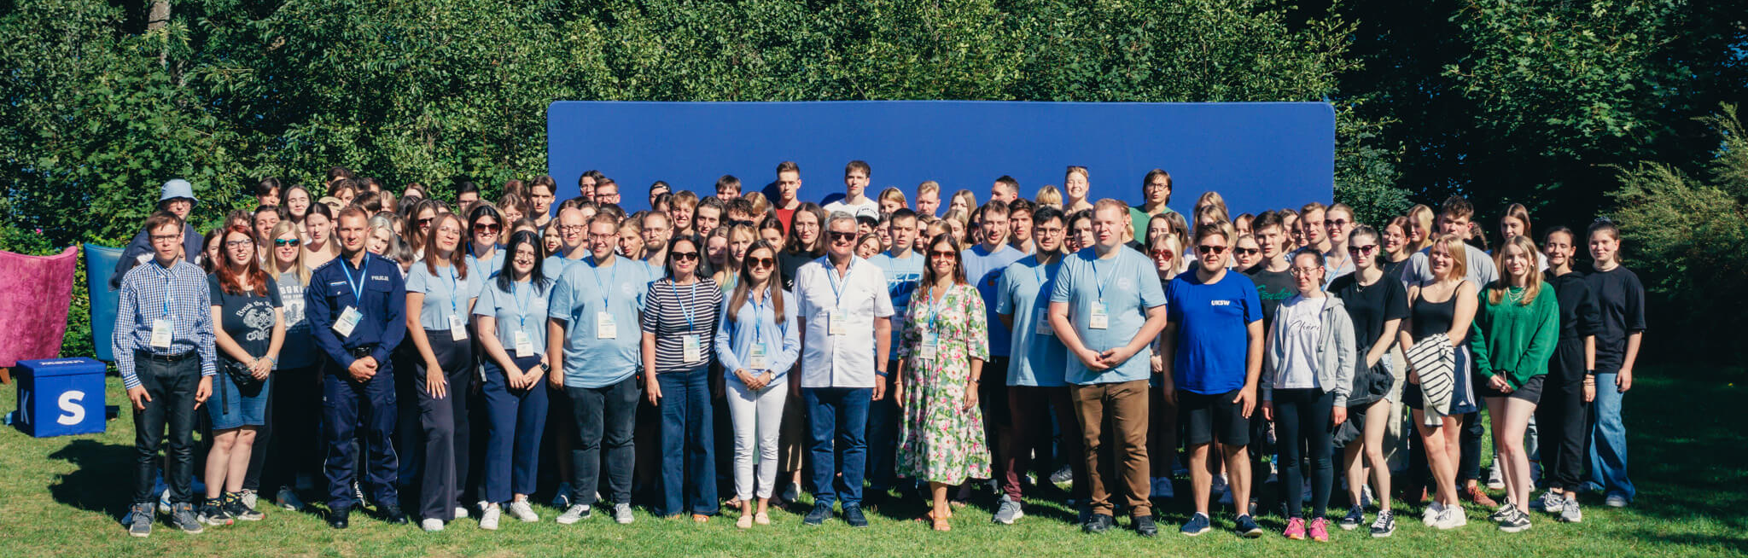
ERASMUS+
Working in Erasmus+ partnership with over 300 European universities UKSW enables POLISH AND FOREIGN STUDENTS AND EMPLOYEES to explore the new fields of knowledge, visit breath-taking places and develop new opportunities. Every year many ACADEMIC TEACHERS go on research stays to UKSW Erasmus+ partners and every year our University is enhanced with guest lectures given by distinguished scholars and practitioners.
The Erasmus+ program covers also UNIVERSITY ADMINISTRATION STAFF who expand their knowledge and professional competences by participating in various training courses and workshops organized by foreign institutions. It is also an opportunity to exchange experiences and good practices used at partner universities.

Slide 12
UKSW International Relation Office not only helps Polish and foreign students to take part in various international programmes but also realizes various transnational projects.
One of the UKSW priorities is to tighten and develop cooperation with the world’s leading scientific units and to strengthen its position among European scientific institutions. By 2021, UKSW has concluded 96 bilateral agreements with partner institutions from around the world.
You are welcome to join us and/or propose your partnership. We are ready to consider all cooperation proposals.
We realize various international projects
You are welcome to join us and/or propose your partnership
UKSW INTERNATIONAL OFFICE
We are ready to consider all cooperation proposals

Slide 13

UKSW WELCOME CENTRE
Welcome Centre provides International Students and Guests with a necessary support in various aspects related to their stay in Poland and their studies at our University.

Slide 14
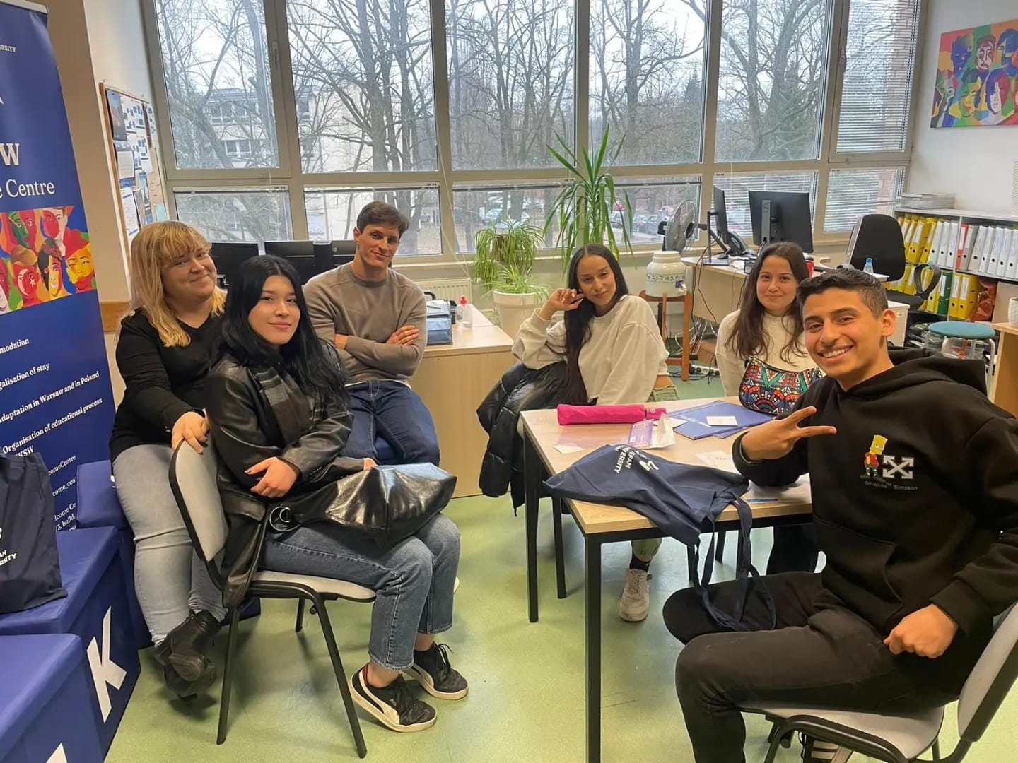
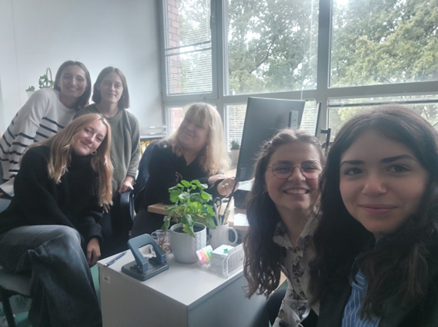
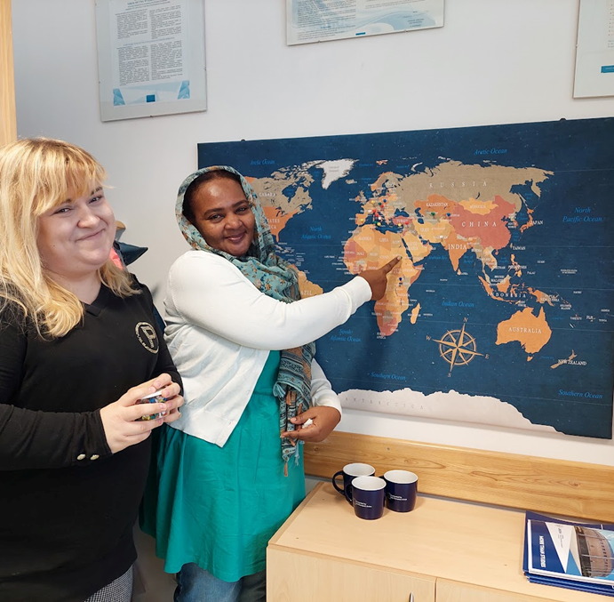
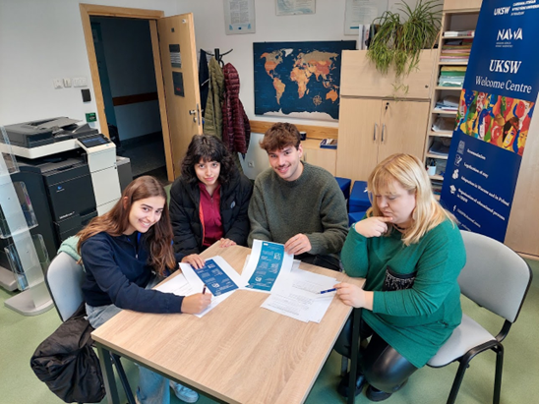
UKSW WELCOME CENTRE – A FRIENDLY VENUE FOR INTERNATIONAL STUDENTS AND STAFF

Slide 15
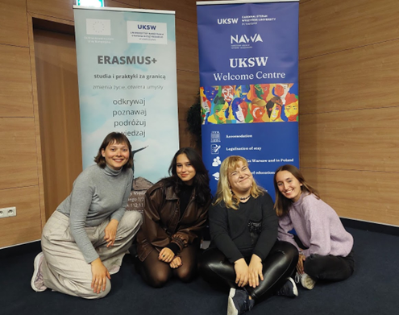
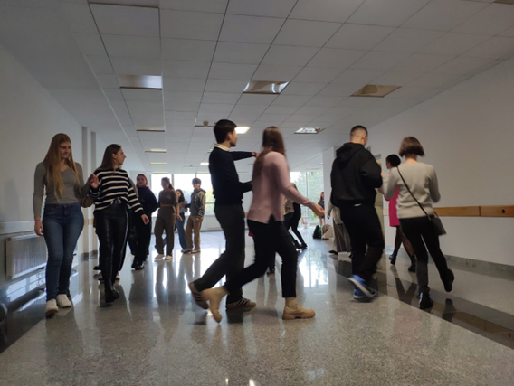
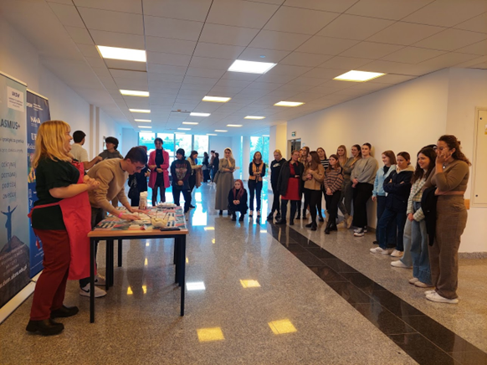
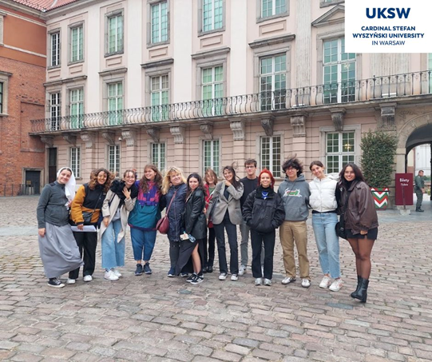
UKSW WELCOME CENTRE – ORGANISATION
VARIOUS SOCIAL AND CULTURE EVENTS

Slide 16

SOCIAL ACTIVITY
UKSW NON-PUBLIC KINDERGARTEN is the first academic institution of this kind in Warsaw offering demonstration classes and student internship. Its staff along with the academics from the Faculty of Pedagogical Sciences.
COMMUNITY CENTRE FOR MENTAL HEALTH SCIENTISTS of the Institute of Psychology have developed a pioneering programme for the prevention of mental health crises in children and young people. The project is being implemented by the university company - Ezra UKSW Ltd.

Slide 17
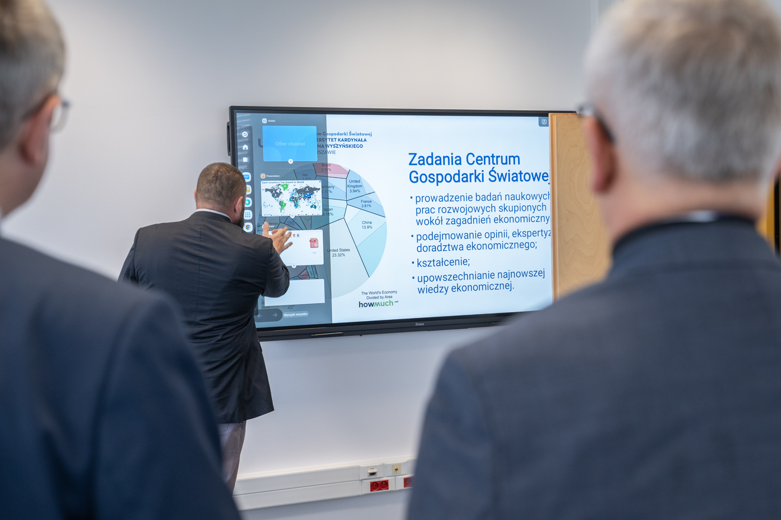
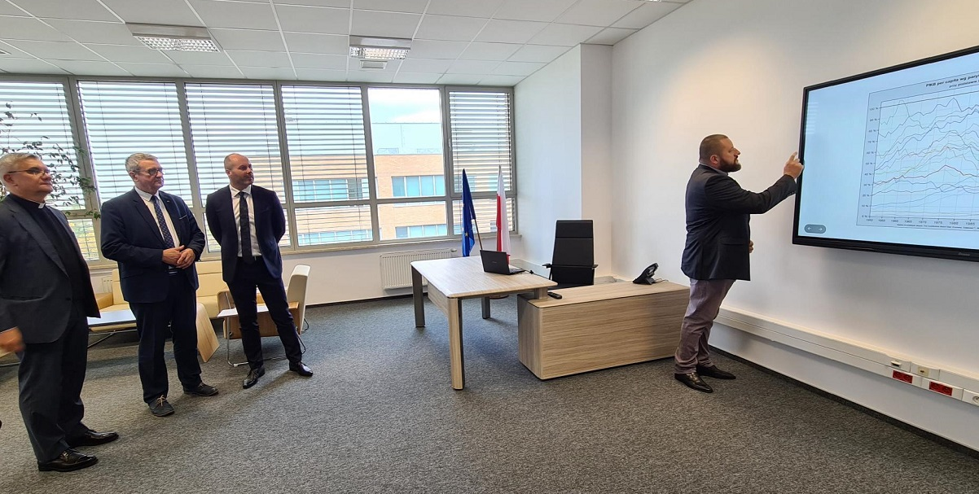
SCIENCE FOR BUSINESS
UKSW WORLD ECONOMY CENTRE, with its modern site on the Wóycickiego campus, is an university research unit dealing with current economic events, processes, and phenomena as well as dissemination of economic knowledge.
The establishment of the World Economy Centre responds to the contemporary socio-economic challenges. The Centre conducts development work of an interdisciplinary nature in areas related to the socio-economic development of Poland, Europe, and the world.

Slide 18
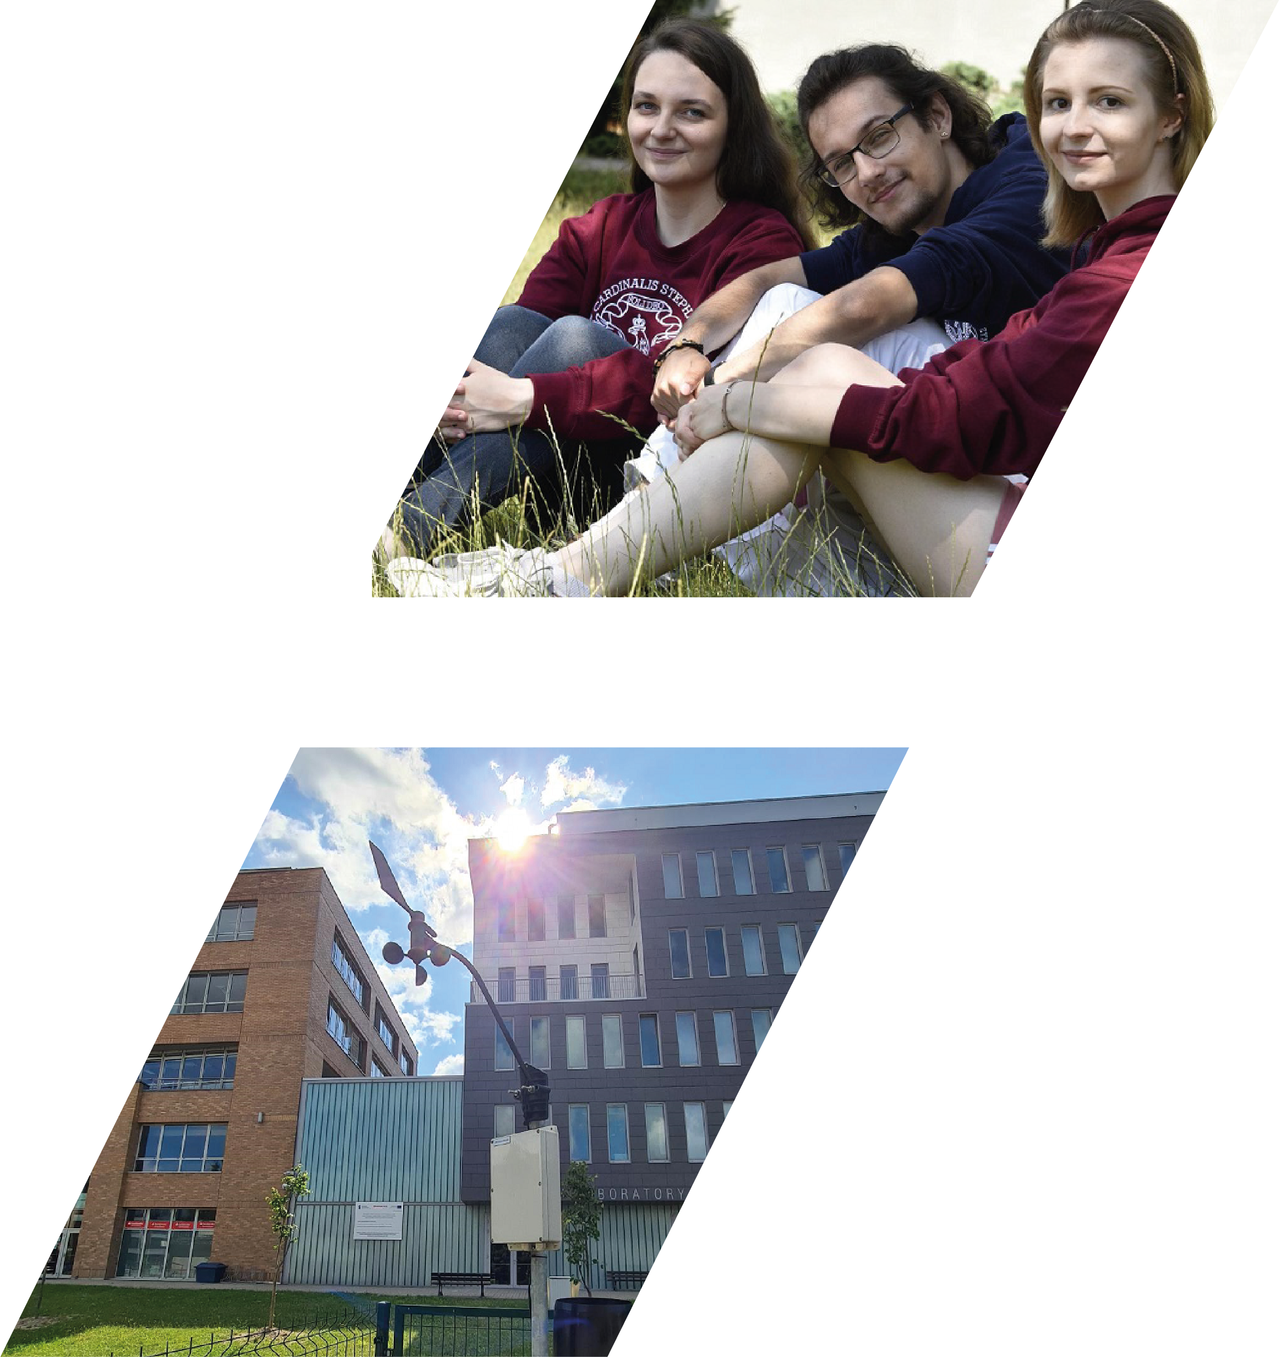
ACADEMIC INCUBATOR OF ENTREPRENEURSHIP prepares students to enter the market and to cooperate with the business community. Trainings and workshops offered by the Incubator to the UKSW students are in line with labour market trends. Moreover Academic Incubator of Enterpreneurship organizes Career Days, business conventions, meetings with experienced enterpreneurs as well as individual consultations concerning professional development.
WEATHER STATION at the Ecology and Ecophilosophy Centre at Wóycickiego Campus is a scientific installation station that monitors air pollution with particulate matter PM 2.5 and PM 10 in real time. Data collected at the station are updated and presented on a dedicated platform and TV screen in the building of Natural Sciences Laboratory Centre.

Slide 19

MULTIDISCIPLINARY RESEARCH CENTRE
MULTIDISCIPLINARY RESEARCH CENTRE is the latest UKSW investition created in response to the evolving needs of the scientific and business milieu. The Centre, unique on a national and international scale, is based in Dziekanów Leśny near Warsaw.
Its purpose is to introduce innovative solutions of digital and information technologies to the economy and state administration.
The Centre brings together specialists in data science, artificial intelligence, machine learning, cybersecurity, medical, technical and life sciences as well as humanities and social sciences.

Slide 20
• 3D Printing Laboratory
• Geoinformation Research Laboratory
• Measurement and Environmental Research Laboratory
• Cybersecurity Laboratory
• Communications Systems Laboratory
• Time-Critical Processing Laboratory
• Spherical Simulator and Visual Simulation Laboratory
MULTIDISCIPLINARY RESEARCH CENTRE
RESEARCH UNITS

Slide 21
VR Laboratory
RTV and Media Studies Laboratory
Numerical Methods and Analysis Laboratory
Large-Scale Data Processing Laboratory
Secure Data Storage and Processing Laboratory
Creative Space Laboratory
MULTIDISCIPLINARY RESEARCH CENTRE
RESEARCH UNITS

Slide 22
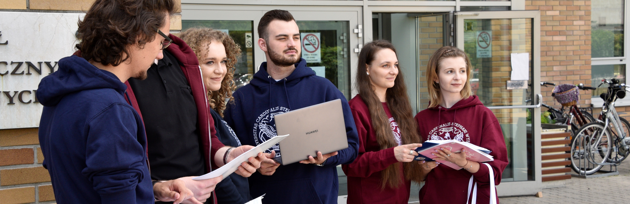
STUDIES IN ENGLISH
The Specialist Theology Studies at the Faculty of Theology at the Cardinal Wyszynski University in Warsaw provide a unique opportunity to obtain wide theological knowledge and, at the same time, to specialize in one of the main domains of theology. The graduates are to be not only experts in their narrow domains but also to have extensive theological knowledge and be prepared to perform at work as a responsible, seasoned and committed professional.

Slide 23
@UniwersytetKardynalaStefanaWyszynskiego
@Uniwersytet Kardynała Stefana Wyszyńskiego
@UniwersytetKardynalaStefanaWyszynskiego
@uksw_uniwersytet
@uksw_uniwersytet
@UKSW_Warszawa
www.uksw.edu.pl/en

